Slide 1

FoodPanda Database
Name: Syed Jazil Hussain
Student ID: 14369793

Slide 2
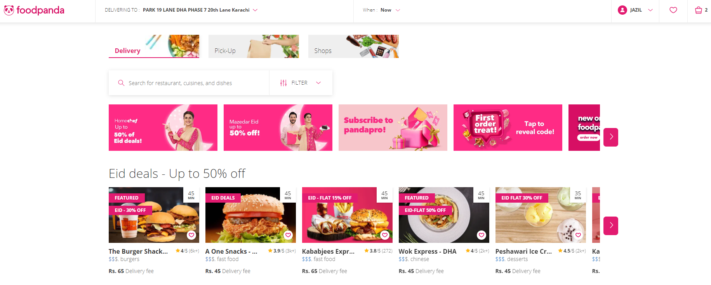
Real World Domain
FoodPanda is an online food and grocery delivery platform.
https://www.foodpanda.com

Slide 3
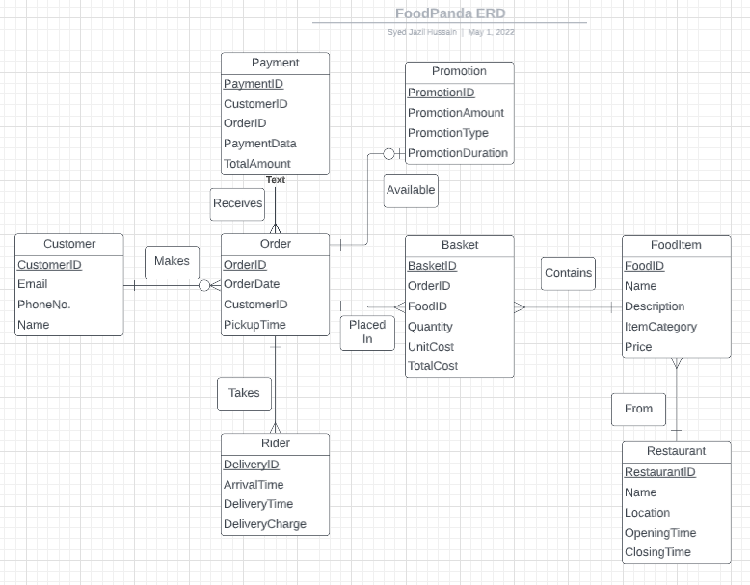
Complete ERD of FoodPanda.

Slide 4
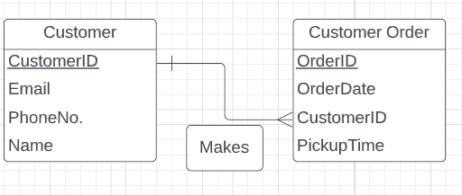
One to Many relationship.
Tables show that each customer can have more than one order, but an order can only have one customer at a specific time.

Slide 5
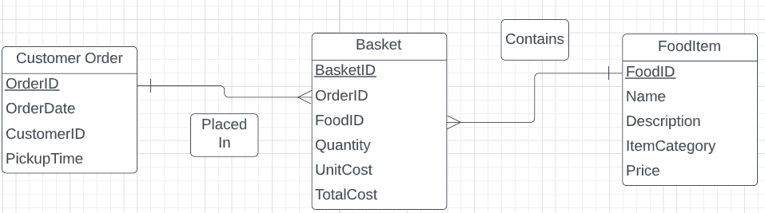
Many to Many relationship
The table below shows that an order can have many food items and one food item can be associated with many orders.

Slide 6
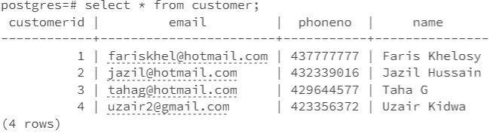
A simple query of a single table
select * from customer;
The simple query above selects all the data from the customer table and displays it.

Slide 7
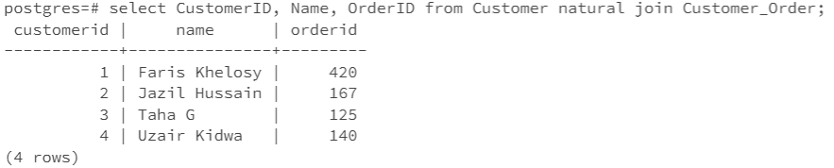
A query which uses the words “natural join”
select CustomerID, Name, OrderID from Customer natural join Customer_Order;
The query above displays the customerid and name from the Customer table and orderid from the Customer_Order by combining the two tables using natural join.

Slide 8
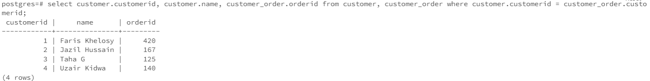
The cross-product equivalent to the “natural join” query prior
select customer.customerid, customer.name, customer_order.orderid from customer, customer_order where customer.customerid = customer_order.customerid;
The query above displays the customerid and name from the Customer table and orderid from the Customer_Order by combining the two tables using a cross-product equivalent to the natural join.

Slide 9
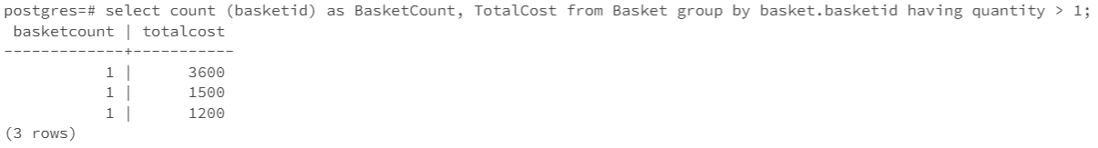
A query involving a “Group By”, also with a “Having”
select count (basketid) as BasketCount, TotalCost from Basket group by basket.basketid having quantity > 1;
The query above displays the number of baskets that are grouped by basketid as well as the total cost. The having function prevents the results of entities with quantity <=1 from being displayed.

Slide 10
A query which uses a sub-query
select foodid, name, itemcategory, price from fooditem where itemcategory = ‘Pizza’ and price = (select max(price) from fooditem where itemcategory = ‘Pizza’);
The query above displays the foodid, name of the food, the category and the price using the FoodItem table. The sub query used discovers the most expensive pizza available.

Slide 11

Illustrate the use of CHECK statements.
Examples of check statements:

Slide 12
Action Statements
Examples of action statements: Specifies that when the customerID row is deleted from the payment table, other rows referencing it should also be automatically deleted.
Is used to prevent the deletion of the FoodID foreign key from the Basket table.

Slide 13
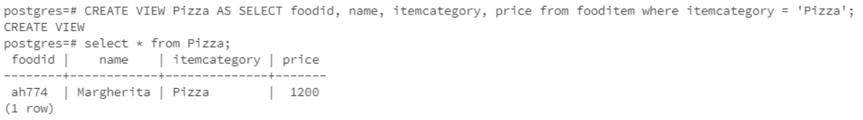
SQL View
CREATE VIEW Pizza AS SELECT foodi, name, itemcategory, price from fooditem where itemcategory = ‘Pizza’; select * from Pizza;
SQL view used to display the foodid, name, itemcategory and price of all the pizzas in the FoodItem table.

Slide 14
Thanks for listening.

